Slide 1
Conservation Agriculture

Slide 2
Introduction
What is Conservation Tillage?
Conservation Tillage refers to a number of practices that in combination
conserve soil, moisture, fertiliser, seeds, energy, time and money. With
Conservation Tillage (CT), Minimum Tillage is used to plant the crop but
other simple techniques are also applied, which:
Protect the soil from the damaging effects of rain splash;
Reduce run off and keep more of the rain on the fields, this is called rain harvesting;
Make the best use of costly fertiliser and seeds; and
Allow farmers to finish land preparation well before the rains come so they are ready in good time.

Slide 3
What is Conservation Farming?
Conservation farmers use Conservation Tillage methods to establish
their crops but they also grow legumes in rotation with their other crops.
Legumes, depending on the varieties grown, fix Nitrogen, improve fertility, break soil pans and are an excellent source of protein for the family.
Conservation farmers recognise the value of trees and live in harmony
with the land rather than destroying it.

Slide 4
Adoption Definitions
It is sometimes difficult to decide whether a farmer is a true
adopter of CT or Conservation Farming (CF).
The definitions below describe 3 levels of adoption, from partial adoption through to full adoption of CF.
These definitions are non negotiable because they describe practices that are the very foundation of hoe CF

Slide 5
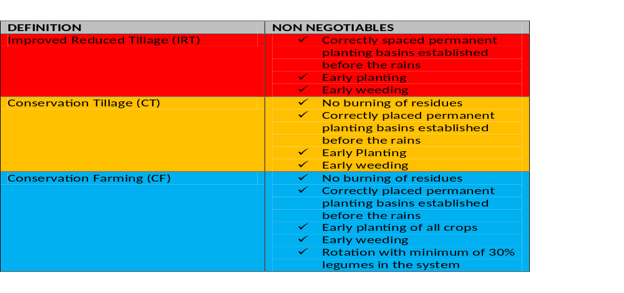

Slide 6
Main Benefits of Conservation Farming
CF involves adopting a number of husbandry practices that together comprise a complete farming system. If these practices are followed
correctly, a number of important benefits arise:
Farmers can plant a larger area because they are not moving or turning over the soil before they plant. This saves money and time. For
example, conventional ploughing or ridging 1 hectare of land to 10cms depth involves turning over or moving 1,000 tons of soil.
Farmers can begin to prepare their land as soon as they have harvested. This allows for early planting at the onset of the rains, which is
critical for success. Early land preparation and rapid planting also permit early weeding.

Slide 7
Main Benefits of Conservation Farming
• Labour requirement for land preparation is spread over several months rather than being done at once. It is therefore more suitable for
women.
• Fertilisers and seeds are increasingly costly. Accurate placement of fertilisers and seed reduces wastage and allows optimal use by the
crop.
• Retaining residues reduces soil and water loss, improves infiltration, reduces soil temperatures and, in time, improves soil fertility.
Conservation Farming minimises crop loss in drought years and improves food security.

Slide 8
Main Benefits of Conservation Farming
• Planting holes or ‘basins’ concentrate early rainfall around the seeds, accelerating emergence and improving crop stands.
• Because seeds are planted in the same place each year, residual fertiliser from cereal crops can be taken up efficiently by subsequent
crops. Deep rooting crops can be used in rotation to break pans by making root channels which weaker rooting crops can follow;
• Because the inter-row is never ploughed, weed populations will decline over time as long as weeds are not allowed to seed.

Slide 9
Main Benefits of Conservation Farming
Rotations with legumes reduce the requirement for artificial fertilisers. Pigeon peas and other legumes also have strong roots that break plough pans and aerate the soil.
Pigeon peas also recycle phosphorous from deeper layers and make it available to shallower rooted crops that follow in rotation.
Early maturing varieties of Cowpea and Gram provide a high protein source in February when food is generally scarce.
• Handhoe CF does not entail the need for purchasing any additional capital equipment by the smallholder. It is also easy to understand
and apply.

Slide 10
Introduction
The conservation farming (CF) system they advocate involves:
dry-season land preparation using minimum tillage methods (either ox-drawn rip lines or hand-hoe basins laid out in a precise grid of 15,850 basins per hectare);
no burning but rather retention of crop residue from the prior harvest;
planting and input application in fixed planting stations; and nitrogen-fixing crop rotations.

Slide 11
The CF system enables farmers to plant with the first rains when seeds will benefit from the initial nitrogen flush in the soil.
By breaking pre-existing plow-pan barriers, the CF basins and rip lines improve water infiltration, water retention and plant root development.
The precise layout of grids and planting lines enables farmers to locate fertilizer and organic material in close proximity to the plants, where they will provide greatest benefits.

Slide 12
Evidence from similar technologies in other parts of Africa suggests that the effectiveness of conservation farming will vary not only across regions but also across crops and over time, due to variations in weather and rainfall.
In addition, many of the benefits of CF -- including improved soil structure, gains from nitrogen-fixing crop rotations and reduced field preparation labor -- occur gradually and over time.

Slide 13
Therefore, it will be important to establish long-term monitoring efforts for conservation farming and control plots across a broad range of geographic settings, crops and seasons.
Results and their interpretation are from a survey of 125 farms in Central and Southern provinces during the 2001/2 cropping season.

Slide 14
Principles of Conservation Agriculture
The main principles of conservation agriculture;
Minimum soil disturbance
crop diversification
permanent soil cover) help to protect the environment and to reduce both the impacts of climate change on agricultural systems (adaptation) and the contribution of the agricultural practices to greenhouse gases
No burning of crop residues
Crop rotation

Slide 15
Benefits of Conservation Farming
The major economic benefits can result from CA adoption:
Time saving and thus reduction in labour requirement.
Reduction of costs, e.g. fuel, machinery operating costs and maintenance, as well as a reduced labour cost.
Higher efficiency in the sense of more output for a lower input.

Slide 16
How Farmers Practice Conservation Farming
Conservation farmers use Conservation Tillage methods to establish their crops but they also grow legumes in rotation with their other crops.
Legumes, depending on the varieties grown, fix Nitrogen, improve fertility, break soil pans and are an excellent source of protein for the family

Slide 17
What are conservation techniques
Conservation techniques like terracing, contour farming, and planting windbreaks provide effective countermeasures that halt the soil from being washed or blown away.
Beyond agriculture, soil conservation has a profound impact on biodiversity as well.

Slide 18
Some examples of the differences between conventional and conservation farming
Conventional farming
Some aspects of conventional farming negatively affect crop yields:
Burning of residues (crop waste) before ploughing Residues are useful for:
  protecting the soil from being washed away, improving water infiltration and reducing soil temperatures
    maintaining soil structure and fertility when termites and worms incorporate them into the soil.
  Ploughing using oxen Ploughing the whole field wastes energy, reduces yields and destroys the soil:
    Farmers usually plough after the rains. This means that there is a delay in preparing the land. For each day of delay after the first planting rains, some of the potential yield is lost.

Slide 19
  The ploughed soil is exposed to wind and rain which remove the surface soil.
Ridging up with a hoe This is where ridges are made into the soil to leave furrows that act like a drain. The problem with this is that rain water starts to erode the ridges and gullies soon develop.
Hoe minimum tillage This is where a hoe is used during the first good rains to make planting holes or to scratch planting lines. It is easier to do than ploughing and uses less labour. However, as the soil between the holes or planting lines remains hard, the rain runs off it and takes the fertilisers with it.

Slide 20
Conservation farming
This is a combination of methods which aim to conserve water, soil quality, moisture, fertility and seed production, as well as the farmer’s energy, time and money.
Some of the key aspects and benefits include:

Slide 21
Conservation Farming
Planting in basins
Farmers create basins in the soil in which seeds can be planted.
When the rains come the water is trapped in the basins, allowing roots to develop and stopping the top soil and fertiliser being washed away.

Slide 22
Leaving crop residue for the next harvest
Farmers are encouraged to leave the residues rather than burning them.
This reduces soil and water loss, improves infiltration, reduces surface temperatures and in time improves soil fertility.
Because seeds are planted in the same basin each year, the fertiliser left from the previous crop can be absorbed by the new crop.

Slide 23
Nitrogen-fixing crop rotations
Farmers are encouraged to grow legumes and other nitrogen-fixing crops in rotation to increase the natural soil nutrients.
This will reduce the need for artificial fertiliser and enable them to diversify from maize into less hardy crops.

Slide 24
Early planting during the first rains
This means that farmers need to prepare land as soon as they have harvested the previous crop.
Planting during the first rains enables the seeds to benefit from the nitrogen that the rains flush through the soil.

Slide 25
Basic Conservation Farming Steps for Hoe Farmers
1. Keep residues in the field
Do not burn crop residues from the last harvest. Leave them where they are. A minimum of 30% ground cover is recommended.
The more residues left on the land the better.
Residues reduce sheet erosion and capping, allow the rain to soak into the soil and, when they are harvested by termites, add valuable organic matter to the soil.

Slide 26
Step 2: Get Prepared Early
To prepare their land, hoe farmers will need the following:
Teren Rope; strong hoes, 2 x 90cm row sticks; 2 pegs to hold the rope when it is stretched across the field; fertilizer cups and a Coca-Cola tin.
If the soil is hard, the Chaka hoe is recommended as ordinary weeding hoes will break and are not suited to digging. The Chaka hoe, with an extra strong and long blade is required.
The Teren Rope is an essential tool for the Conservation Farmer because it ensures accurate spacing of the basins. CF is about precision.
The Teren Rope consists of a rope or string with bottle tops squeezed onto it at 70cm Centre. It is used to mark out where to dig the planting basins for the correct spacing.

Slide 27
Marking Out the Permanent Planting Basins
The Teren Rope is used to mark out where to dig the planting basins. These are spaced at 70cms along the row and the rows are 90cms apart.
There will be 15,850 basins per hectare. Stretch the rope across the prevailing slope using the 2 pegs to anchor it.
Keep it well clear of the ground so it remains straight in spite of trash and clods brought up during the digging of the basins. The position of the bottle tops marks the edge of the elongated basins. The basins are not round but rectangular in shape.
Use the 90cm sticks to get the correct spacing when you move the Teren Rope to the next row.

Slide 28
Step 4: Digging the Basins
The basins should be dug well before the onset of the rains.
CF means doing work in advance, so you are ready rather than being overwhelmed when the rains come.
Making the basins when the rains have already started means you have missed one of the main benefits of CF.
When digging a basin, swing the Chaka hoe like an axe using the weight of the hoe blade to penetrate the soil.
This is why the Chaka hoe must have a long handle. Cut out slices of soil working forwards.
When you have finished a basin, move backwards to the next mark and start digging the next basin.
Following this simple method will save you days of work.

Slide 29
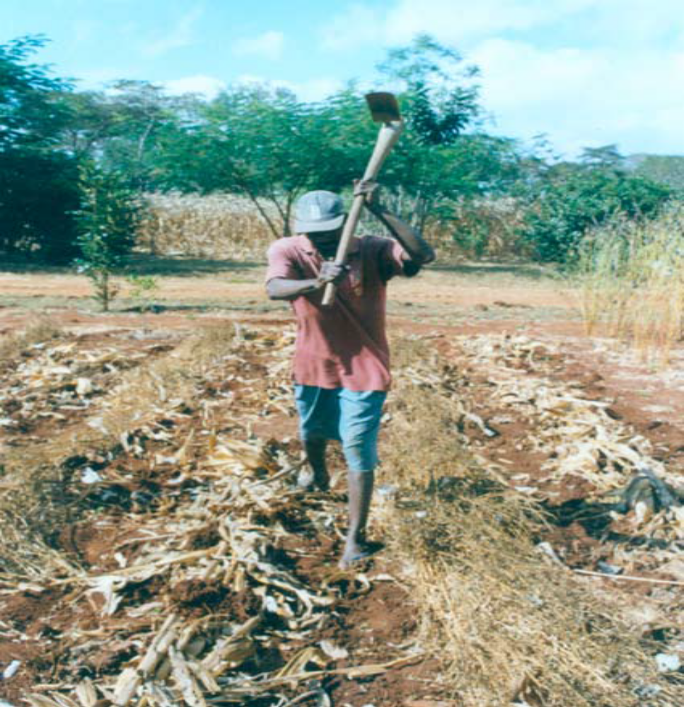

Slide 30
Step 5: Make Basins the Correct Size
The basin should be 20cms deep, 30cms long and the same width as
the blade of the hoe.
If you place your outstretched hand down the hole, the top of the basin should be level with the bone on your wrist.
This depth will ensure that any hoe or plough pans are broken.
The basin needs to be 30cms long so that the seeds of different crops can be spread along the basin.
When the plants emerge they will not be overcrowded.

Slide 31
Digging basins in compacted soils is a hard task.
Farmers who dig large round basins usually waste their time.
Each of these basins takes 45 seconds to 1.5 minutes to complete
Over 15,850 basins (one hectare), takes about 197 hours (or 33 days) of extra work.

Slide 32
Step 6: Start Land Preparation Early and Work Steadily
Farmers should be advised to start land preparation as soon as the harvest is over.
The best way is for the adults in the family to work for about 3 hours each morning.
3 adults can dig about 500 basins in 3 hours.
In this way, 1 hectare can be completed in 4 weeks

Slide 33
Step 7: Applying Basal Fertilisers, Manure and Lime
Properly dug and precisely spaced basins allow farmers to be extremely accurate in the application of fertilizer and seeds.
Guesswork is no longer necessary and the inputs can be placed exactly where they are needed.
Wastage is minimised.
Kraal manure is a valuable resource that farmers often fail to take full advantage of.
With CF, manure is scattered across the bottom of the basin.
2 full Coca-Cola tins, or 1 double handful, per basin is recommended. This is the same as 4 tons (or 4 scotch carts) per hectare.
Farmers who spread manure across the field and then plough it in, waste most of it.

Slide 34
Applying Fertiliser & Lime
The Number 8 fertiliser cup is recommended for the application of fertiliser and lime
The fertiliser should be scattered in the bottom of the hole. One No.8 cup per basin gives 125kgs per hectare of “D” Compound and 100kg of Urea.
Lime can be applied at the same time as basal dressing. 2 cups of lime per basin gives 350kgs per hectare
Manure, basal fertiliser and lime can be applied as early as August and should always be applied to the bottom of the basin and not used as a side dressing after the crop has emerged

Slide 35
Applying Fertiliser Easily and Back-filling Basins
To apply inputs easily, tie the ends of the same side of a fertiliser sack together and sling it over your shoulder.
Fill it with 10 to 15kgs of fertiliser or manure. Using the cup or Coca-Cola tin, toss the fertiliser into each basin from hip height so that it spreads out.
After the inputs have been applied in the basins, they should be covered with soil using a hoe. This is called back-filling.
A shallow depression, about the depth of a matchbox, should still remain after this is done.

Slide 36
Step 8: Deciding When to Plant
This depends on the season and is one of the most difficult decisions farmers have to make.
A major advantage of CF is that when heavy rains fall, all the farmers have to do is plant because they are ready.
Most conventional farmers have to combine land preparation and sowing. This complicates and delays the job.
The main objective is to achieve rapid, even and complete emergence of the crop. To achieve these results, timing is critical.
Always plant seed immediately after heavy rain. Never plant several days after rain when the soil is already beginning to dry up.
When the rain stops, continue planting for only 48 hours, then stop planting until the next good shower.

Slide 37
Step 8: Deciding When to Plant
When you plant there must be enough moisture to germinate the seed so the whole crop emerges at the same time.
If you are relying on a further shower of rain to achieve emergence, you could fail.
Make sure your family knows how to plant different seeds so they can help you to finish the job quickly.
Planting should always be completed in 1 day if possible.

Slide 38
Step 9: Sowing Crop Seeds
It is very important to sow crop seeds correctly. If seeds are not sown properly the effort put into land preparation will be wasted.
Seeds must be planted at a correct planting depth for each type of seed.
After covering seeds, the soil should be compacted lightly to ensure good contact between seed and soil so that the seed can absorb water quickly.
Before sowing, check the level of soil in each basin. The hollow in the centre of each basin should be about 5cms.
Rainfall may have caused the soil to slump down so more may need to be added.

Slide 39
4 seeds of maize are sown along the basin and covered with 5cms of soil.
Clods should be broken so the soil makes good contact with the seed.
The aim is to have a stand of 57,000 plants per hectare (90% germination)
For sorghum,10-12 seeds are sown along the basin and covered with 2.5cms of soil.
The aim is a stand of 100,000 plants per hectare.

Slide 40
For soya beans, Sow 10 to 12 seeds along each basin and cover with 2cms of soil.
Do not plant too few seeds as this will reduce the yield.
The aim is to have a vigorous stand of 125-150,000 plants per hectare
Remember that Soya Bean seed needs to be treated with innoculum immediately before sowing.
Follow instructions provided carefully

Slide 41
Before sowing cotton seed, all the soil should be moved back into the basin so it is level with the ground.
Plant a pinch of 6-8 fuzzy, or 2-3 delinted cotton seeds at each end of the filled hole.
The seed should be pushed into the soil but should remain visible.
After thinning to 4 plants per basin, the aim is to have a stand of 63,000 plants per hectare.

Slide 42
Step 10: Thinning & Supplying
Cotton is the only crop where thinning may be necessary.
If the emergence of the crop is poor, supplying is also necessary.
Sowing of supply seeds should be done as soon as possible and before the existing plants are matchbox height (5cms tall).
Only sow into a very moist seedbed
Cotton seedlings should be thinned out before they are 5cms tall leaving 2 strong seedlings at each end of the basin.
This is 4 seedlings per basin or 63,000 seedlings per hectare.

Slide 43
Step 11: Weeding
Early and continuous weeding is a critical element of CF.
If weeds are not allowed to seed, the population of weed seeds in the soil will gradually decline.
Farmers often stop weeding after the crop has matured believing the weeds can no longer do any harm.
This is a serious mistake because each weed will shed thousands of seeds which will germinate the following year and for many years thereafter.

Slide 44
Farmers seldom pay enough attention to weeding and are not aware of the damage that weeds do to crops by competing for water,nutrients and light.
Weeds should never be allowed to grow beyond 5-6cms.
One person can weed 1 hectare of weeds this size in 8-10 days.
If the weeds are 15cms high, the same job will take 20-25 days and the crop will suffer severely.

Slide 45
Step 13: Top Dressing of Maize
On medium to heavy soils, Maize should be top dressed once when it is knee high.
It is best to use 2 people to do this job. The soil should be moist.
The first person scratches a small furrow beside each Maize stand (basin), with a stick.
The second person applies the fertiliser in the furrow with a No. 8 cup and covers lightly with soil.

Slide 46
If the soil is very sandy, the top dressing should be split.
The first dressing is applied at knee height (normally 6 weeks after planting)
The second dressing about 3 weeks later when the Maize is waist height

Slide 47
Rotations and CF
Rotations are an essential part of CF.
Different legumes with different use can be used as rotational crops such as Cowpea, Green Gram, Pigeon pea, Groundnuts and Soya Beans
On most farms, Legumes still occupy less than 10% of smallholder crops in any one season.
Either seed is unavailable or there is no market. The regional and international demand for soya bean and groundnut is large but for other legumes it is small.
Local demand, particularly in urban areas, must be developed.
Legumes provide an excellent source of protein and can be prepared in many different ways, including bean fritters which would provide a more nutritious alternative ‘fast food’ to green Maize.

Slide 48
Planning Your Conservation Farming Rotation
Give some thought to planning your rotation and if you are a beginner start small so you get it right first time.
Divide your home field into approximate 3 equal parts of your field
Cereals – Maize, sorghum or millet
Non legume cash crops – sunflower, cotton and Sesame
Legumes – cash and food crops – Soya, cowpeas,Gram,groubdnuts and field beans

Slide 49
Intercropping and CF (Often Called Cover-Cropping)
Cowpeas are sown immediately the Maize is sown or after the first early weeding about 10 -12 days after the Maize is sown.
The Cowpeas smother weeds, reduce labour for weeding, fix Nitrogen and provide some early protein.
Cowpea yields will, however, be relatively low at 250-500kg/ha due to competition from the Maize.
Maize yield is not affected.
The following year the rows are switched

Slide 50
Fallow Cropping and CF (Low Fertiliser Input System
Where hoe farmers have spare land they are not utilising, Velvet Bean (Mucuna pruriens) is the best fallow crop choice.
Velvet beans are extremely vigorous and smother weeds very effectively.
Velvet beans also fix over 100kgs of Nitrogen/ha for successive crops.
This is very valuable.

Slide 51
The Importance of Early Planting – The Nitrogen Flush
The importance of early planting of all crops cannot be over emphasized.
CF farmers who have completed land preparation in the dry season but fail to plant immediately after the first planting rains have missed out on one of the most important benefits of CF.
Maize that is planted early usually do well bearing bigger cobs
This is so because the plants that emerges with the first rains benefits from Nitrogen released by soil microbes.
This is called the Nitrogen Flush.

Slide 52
Some Common Mistakes and
Misunderstandings About CT/CF
Back-filling the planting basins before sowing is essential, otherwise poor emergence and water logging will occur when rainfall is continuous. Cotton is particularly susceptible.
Pot-holes are not the same as planting basins or planting holes. Pot-holes are dug in the inter-row after the rains have started. Their purpose is to capture extra rainfall.
Basins should be of correct dimensions

